Slide 1
Cognitive Modelling

Slide 2
Cognitive Modelling
Model
A model is a simplified (often formal) representation of reality.
Purpose: to explain or predict aspects of the real world.
Cognitive Modelling
Special kind of modelling that focuses on cognitive processes (thinking, memory, categorization, decision-making, etc.).
Uses formal representations like:
Mathematical models (equations, probabilities)
Algorithmic models (step-by-step procedures)
Symbolic models (rules, logic)
Aim: to predict or explain human behavior based on those processes.

Slide 3
Computational Modelling
Computational Modelling
Cognitive models (or other models) are implemented as computer programs.
Simulation produces an output that corresponds to predicted behavior.
Example: If the cognitive process is categorization, the computational model might use:
Decision trees
Neural networks
Rule-based systems

Slide 4
What are Formal Models
Formal Models
Can be Quantitative (mathematical equations) or Procedural (computer programs).
These are implementations of a theory — they turn abstract ideas about cognition into something concrete/testable.
Purpose of the Model
To mimic (“fit”) human data from tasks (e.g., reaction times, error rates, choices).
Example:
Memory models → simulate forgetting curves.
Perception models → simulate visual recognition.
Decision-making models → predict choices under uncertainty.

Slide 5
What are Formal Models
Domains in Cognitive Psychology where models exist:
Memory
Perception
Language comprehension
Decision-making (and others like attention, learning, problem-solving).
The “Why” of Modeling
Not just description but explanation + prediction.
Models allow researchers to:
Test theories formally (not just in words).
See if assumptions about cognition hold up.
Compare competing theories quantitatively.
Predict new behavior that hasn’t yet been observed.

Slide 6
Advantages of Computational Modeling
Precision & Predictability
Pushes the predictive aspects of a theory.
Provides formal, precise, and abstract specifications of ideas.
Clarity & Rigor
Avoids ambiguity and vagueness that often exist in verbal theories.
Forces researchers to fully specify all assumptions in the theory.
Scientific Strength
Generates both quantitative (numerical) and qualitative (pattern-based) predictions.
Makes cognitive psychology more like the “real” sciences (e.g., physics, biology) where models yield measurable predictions.

Slide 7
Is cognition information processing?
Church–Turing Thesis
States that any computable function can be performed by a Turing Machine.
Suggests that cognition, if algorithmic, could also be modeled computationally.
Universal Turing Machine (UTM)
A theoretical machine that can simulate any other Turing Machine.
Provides the foundation for modern computers — and the metaphor that the brain could be understood as an “information processor.”
The Information-Processing Metaphor
Mind as a computer: cognition involves representations (data) and operations (algorithms).
Input (stimuli) → Processing (mental operations) → Output (behavior).
Frames thought as a sequence of transformations of information, much like computer programs manipulate data.

Slide 8
We keep talking about what “machines” can do
When we say “machine” or “computer” in the abstract, we don’t just mean physical hardware.
Instead, we mean:
A mechanism that performs certain procedures in certain ways.
Those procedures are often formalized as algorithms or effective procedures.
So what is an algorithm?
An algorithm = a step-by-step procedure for solving a problem or transforming input into output.
Key properties of algorithms:
Well-defined (no ambiguity).
Finite (terminates eventually).
Effective (each step can be carried out mechanically).
This is why algorithms serve as the bridge between:
Computers (machines) → executing procedures, and
Cognition (minds) → potentially being understood as algorithmic information processing.
Machines = algorithms executed mechanically
Minds = cognition as algorithms operating on information (representations)

Slide 9
What is an “Algorithm” or “Effective Method”?
Informal definition:
A finite sequence of well-defined instructions for accomplishing some task.
Slightly more formally, a method M is called an “effective method” if:
Finite Sequence of Instructions
An algorithm is not endless; it must have a clear stopping point.
Well-defined
Each step must be precise and unambiguous — no guesswork.
Finite Steps → Definite Output
Following the method guarantees a result within a limited number of steps.
Human-executable
In principle, a person could carry it out with just paper and pencil (no machines needed).
No Creativity Required
It’s mechanical: no new insight or problem-solving is needed once the algorithm is defined.

Slide 10
Algorithm → Church–Turing Thesis → Universal Turing Machine → Cognition as Computation ?
1. Algorithm (Effective Method)
Definition: A finite sequence of well-defined, unambiguous steps that guarantee a result.
Example: A recipe for long division, sorting a list, or following a cooking recipe.
Key: Mechanical, no creativity required.
2. Church–Turing Thesis
Claim (1930s): Anything that can be computed by an effective method can be computed by a Turing Machine (or equivalently, a lambda calculus function).
This thesis is not a theorem (not formally proven) — it’s a foundational assumption about the limits of computation.
In short: Algorithm = Turing-computable process.

Slide 11
3. Universal Turing Machine (UTM)
Alan Turing’s breakthrough idea.
A UTM is a single machine that can simulate any other Turing machine, provided it is given the right program + data.
This is the theoretical foundation of modern computers (one general-purpose device, instead of different machines for each task).
4. Cognition as Computation (Information-Processing Metaphor)
If cognition = information processing,
and information processing = algorithmic computation,
and all algorithms can be executed by a Universal Turing Machine,
→ Then in principle, a computer can model cognition.

Slide 12
Turing machines
The informal concept of algorithm is captured by any of the
equivalent formalizations.
The formalization most commonly employed: Turing Machines
Hence:
Turing machines can do anything that can be described as an effective procedure

Slide 13
What is a Turing Machine?
A Turing Machine is an abstract mathematical model of computation proposed by Alan Turing (1936). It captures the fundamental idea of what it means to “compute” an algorithm.

Slide 14
Components:
Infinite Tape
Serves as memory.
Divided into discrete cells, each holding a symbol (e.g., 0, 1, blank).
Tape Head
Can read the symbol in the current cell.
Can write a new symbol into that cell.
Can move left or right along the tape.
Finite Control (Program)
A set of rules (like a lookup table).
Tells the machine, given the current state + symbol read, what action to take:
Write a symbol,
Move left or right,
Change to a new state.

Slide 15
How it works
At each step, the machine:
Reads the current symbol.
Looks up the rule in its program.
Writes a symbol, moves, and changes state.
This process continues until it reaches a halting state (or runs forever).
Why It Matters:
Simple but powerful: can simulate any algorithm.
Basis of the Church–Turing Thesis → "Anything computable can be computed by a Turing Machine."
Inspiration for the modern digital computer.

Slide 16
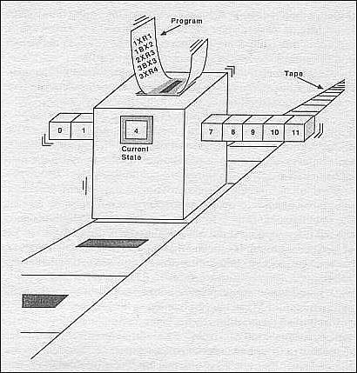
A Turing Machine

Slide 17
Turing Machines: more detail
A read/write head, reading a single cell on an infinite tape with symbols from a finite alphabet;
A finite number of internal states, one designated as the “start” state;
Three possible actions:
move right,
move left,
change what’s on the tape.
A finite set of instructions specifying what to do, depending on the state and what is being read.
(Current State, Symbol Read) → (New State, Symbol to Write, Move Left/Right)

Slide 18
TMs can be identified with sets of quadruples
Each quadruple is an instruction that tells the machine what to do depending on what state it’s in and what it’s reading on the tape.
<STATE, SYMBOL, ACTION, NEW STATE>
where the possible actions are writing a different symbol in place of the
current one, moving left, or moving right.
Each step in a computation involves reading a symbol, carrying out an action, and switching to a new state.

Slide 19
Example: an Adder
2+1=3
2 1
Let n be represented by (n+1) 1’s
_
1
1
1
0
1
1
_
_
_
…
+
+
3
_
1
1
1
1
_
_
_
_
_

Slide 20
A Turing machine for adding two numbers: 2 steps
Change the 0 to a 1
Erase the two 1’s at the end
_
1
1
1
0
1
1
_
_
_
…
+
_
1
1
1
1
_
_
_
_
_
…

Slide 21
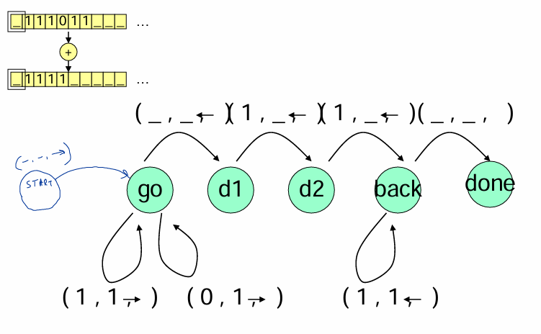
State Diagram for the Solution

Slide 22
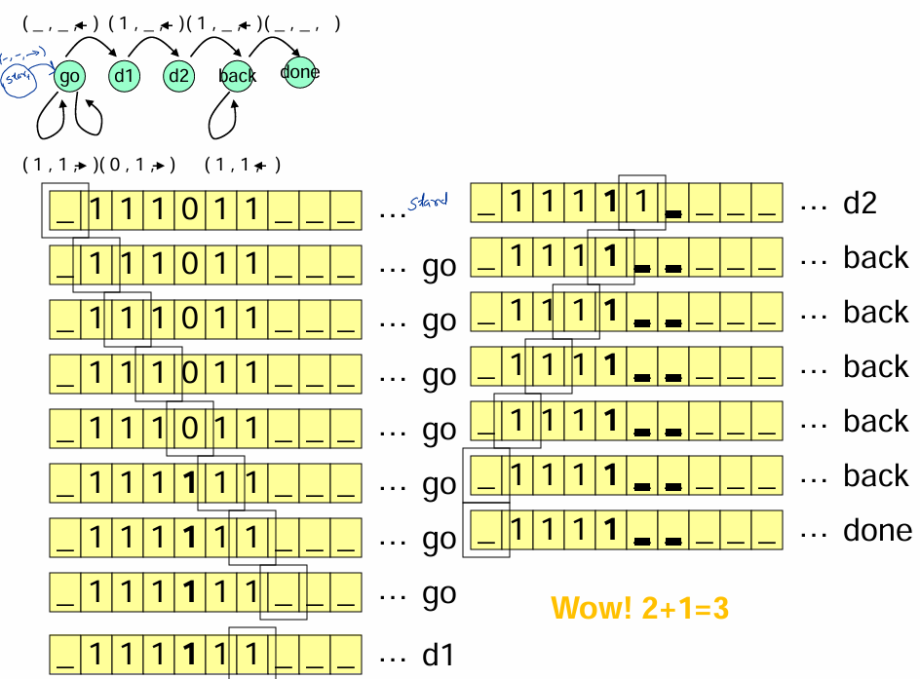

Slide 23
So what?
Ok, now we have a machine that can add two numbers, now what?
As we said earlier, we can build a Turing
machine to implement any single algorithm
Furthermore, we can put on the tape not just the data but THE ALGORITHM TOO!
This means we can build a turing machine to
read other turing machines!!!!

Slide 24
Artificial Intelligence
AI is the study of human intelligence using computers as a tool vs AI as the study of machine intelligence as artificial intelligence
Artificial Intelligence and Cognitive Science: a history of interaction

Slide 25
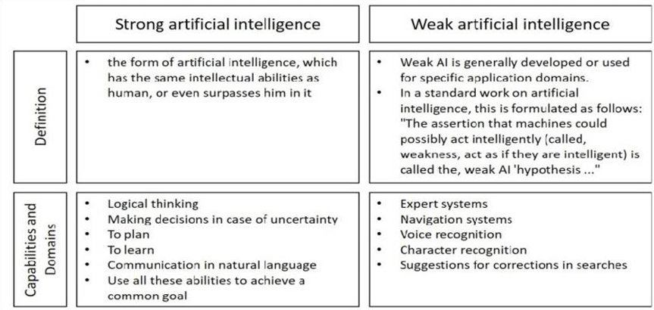

Slide 26
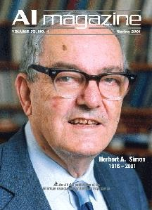
AI and Cognitive Science
"AI can have two purposes. One is to use the power of computers to augment human thinking, just as we use motors to augment human or horse power.
Robotics and expert systems are major branches of that. The other is to use a computer's artificial intelligence to understand how humans think. In a humanoid way. If you test your programs not merely by what they can accomplish, but how they accomplish it, they you're really doing cognitive science; you're using AI to understand the human mind."

Slide 27
Types of AI Research: Goals
Simulate human intelligence – as a model of human competence
Simulate human mental processes – as a
model of human cognitive processes
Produce intelligent behavior to meet a practical need – whether human-like or not (expert systems, etc.)
Produce a general-purpose intelligent agent
(“strong AI”) - nontrivial

Slide 28
Reasoning

Slide 29
LOGIC, n. The art of thinking and reasoning in strict accordance with the limitations and incapacities of human misunderstanding.
The basic [unit] of logic is the syllogism, consisting of a major and
a minor premise and a conclusion
Example:
→ Major premise: All mammals are warm-blooded.
→ Minor premise: All black dogs are mammals.
→ Conclusion: Therefore, all black dogs are warm-blooded.
→ Major Premise: Sixty men can do a piece of work sixty times as quickly as one man.
→ Minor Premise: One man can dig a posthole in sixty
seconds
→ Conclusion: Sixty men can dig a posthole in one second.
This may be called the syllogism arithmetical, in which, by combining logic and mathematics, we obtain a double certainty and are twice blessed.

Slide 30
Rational Thinking
Rational thinking is a mental process that uses logic, reason, and facts to analyze information, solve problems, and make decisions, as opposed to relying on emotions or biases.

Slide 31

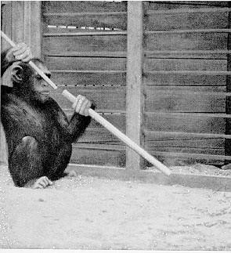
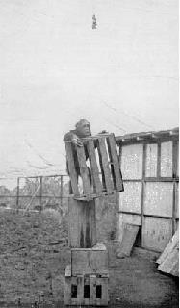
Are you a creature of reason?
Reason has frequently been regarded as distinctly human, and not to be found elsewhere in the animal world. However, recent studies in this area show that animals are capable of some rational thinking.
Question to ponder: Why do birds keep flying while other animals don't keep roaming?
https://www.youtube.com/watch?v=dKvVaRlz 0Y4&t=174s
https://www.dal.ca/news/2020/05/29/animals-that-can-do-math-understand- more-language-than-we-think.html

Slide 32
Syllogism
A syllogism is a logical argument that derives a conclusion from two preceding statements, called premises.
This form of deductive reasoning uses a major premise (general statement), a minor premise (specific statement), and a conclusion (logical inference) to establish a valid argument, even if the statements initially seem illogical.
The Greek word "syllogismos" means "conclusion" or "inference“.
Reasoning
It is a tool for processing information: deducing conclusions, solving structured problems, or exploring implications of known facts.
Reasoning is the mental process of drawing conclusions, making inferences, or solving problems by connecting ideas, facts, or evidence. It’s how we go from what we know → to what we can figure out.

Slide 33
Reasoning does not help us in identifying goals or in identifying problems.
Rather, it helps us derive new knowledge from that which we already know
{
Premise: Premise:
All men are mortal Socrates is a man
Sy logism
Conclusion: Socrates is mortal

Slide 34
Example:
Person A: "I was excited to see that our onboarding process increased our employee retention rates. When I interviewed our employees last week, 98% of them said they are still with the company because of the support they got when they first
started.“
Person B: "I think the real reason everyone likes it here is that we allow dogs in the office.“
Premise 1: If the street is wet, then it just rained.
Premise 2: The street is wet.
Conclusion: It just rained.
Here, premise 1 (“If the street is wet, then it just rained”) is false, since if the street is wet, that doesn’t necessarily mean that it just rained. For example, it’s possible that it rained hours ago and the street didn’t dry, or that a fire hydrant broke and sprayed water everywhere.
Because this argument relies on a false premise, it can be considered logically unsound. However, this doesn’t mean that the conclusion of the argument is necessarily false since even fallacious arguments can have true conclusions, which means that it’s possible that it did indeed just rain.
Reasoning helps us derive knowledge from what we already know — like Person A. But it doesn’t always reveal what people value — like Person B is hinting at.
Sometimes, reason tells us what works, but emotion and intuition tell us why people care.
Important: Reason does not deliver truth. If the premises are nonsense, even the best reasoning will generate nonsense

Slide 35
Types of Reasoning:
1. Inductive Reasoning (Bottom-Up)
Starts with specific observations or data
Forms general rules or conclusions
Uncertain, but useful for discovering patterns
Example:
Every swan I’ve seen is white. → Therefore, all swans are probably white.
You observe facts and induce a rule.
Often used in science, forecasting, and learning.

Slide 36
2. Deductive Reasoning (Top-Down)
Starts with general rules or principles
Applies them to specific cases
Logically certain, if the premises are true
Example:
All humans are mortal. Socrates is a human. → Therefore, Socrates is mortal.
You deduce a conclusion from what is already accepted as true.
Used in mathematics, formal logic, and philosophy.
3. Abductive Reasoning
The best possible explanation.”
Abductive reasoning is when you start with an incomplete set of observations and come up with the most likely explanation.

Slide 37
Inductive reasoning
Inductive reasoning is a type of logical thinking where you draw a general conclusion from specific observations.
The sun has risen in the east every morning up until now
premise
Therefore the sun will rise in the east tomorrow.
conclusion

Slide 38
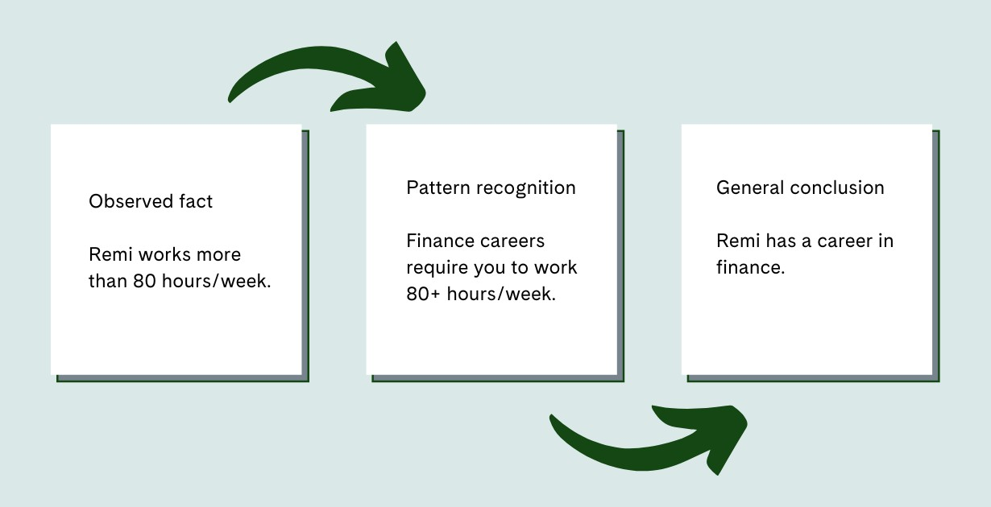
I have been fed every day up until today (21 Aug)
premise Aug)
conclusion
Therefore I will be fed tomorrow (22
Conclusion is that this is probably the case, based on past
experience
. . . even if the premise is 100% factual.
Inductive reasoning is still a helpful form of logical thinking because you arrive at potential and probable solutions. However, you’ll need to test your conclusions to know if they’re right.

Slide 39
Example
Deductive: If it rained, the ground would be wet. It rained. Therefore, the ground is wet. ✅
Inductive: It has rained the last 5 mornings. So it will probably rain tomorrow. 🌧
Abductive: The ground is wet → The most likely reason is that it rained.

Slide 40
Type | Based On | Leads To | Certainty
Deductive | General rules → Specific case | Definitive conclusion | High
Inductive | Specific cases → General rule | Probable generalization | Medium
Abductive | Observations → Best explanation | Most plausible cause | Low

Slide 41
Some more examples
1) Every quiz has been easy. Therefore, the test will be easy.
The teacher used PowerPoint in the last few classes. Therefore, the teacher will use PowerPoint tomorrow.
Every fall there have been hurricanes in the tropics. Therefore, there will be hurricanes in the tropics this coming fall.

Slide 42
Abductive reasoning
Given a range of observations and prior knowledge, abductive reasoning is the task of trying to decide what is the best, or most likely, explanation.
This is rather broad,may involve several distinct kinds of argumentation, andis not assimple to characterise as inductive or deductive reasoning.
“These are my favorite jeans and I can’t fit into them anymore. I must have gained weight.”
I woke up this morning to the sounds of birds chirping. It was beautiful, and a
lovely way to start the day.

Slide 43
Deductive Reasoning
Given as set of premises,and using only rules of logical inference ...
we work to a conclusion that necessarily follows from the premises
Again,if the premises are stupid, no amount of deductive reasoning can overcome that.

Slide 44
Deductive Reasoning
An Example:
The catalog states that all entering freshmen must take a mathematics placement test.
You are an entering freshman.
Conclusion: You will have to take a mathematics placement test.

Slide 45
90% of humans are right-handed. Akhil is human, therefore Akhil is right-handed.
DEDUCTIVE

Slide 46
You are a good student. You get all A’s
Therefore your friends must get all A’s too
INDUCTIVE

Slide 47
All oranges are fruits. All fruits grow on trees
Therefore, all oranges grow on trees
DEDUCTIVE

Slide 48
Mikhail hails from Russia and Russians are tall, therefore Mikhail is tall
INDUCTIVE

Slide 49
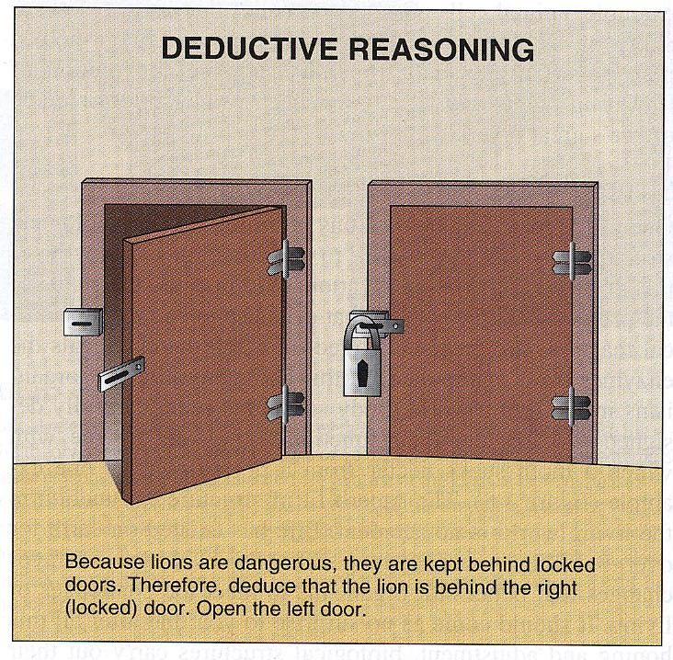

Slide 50
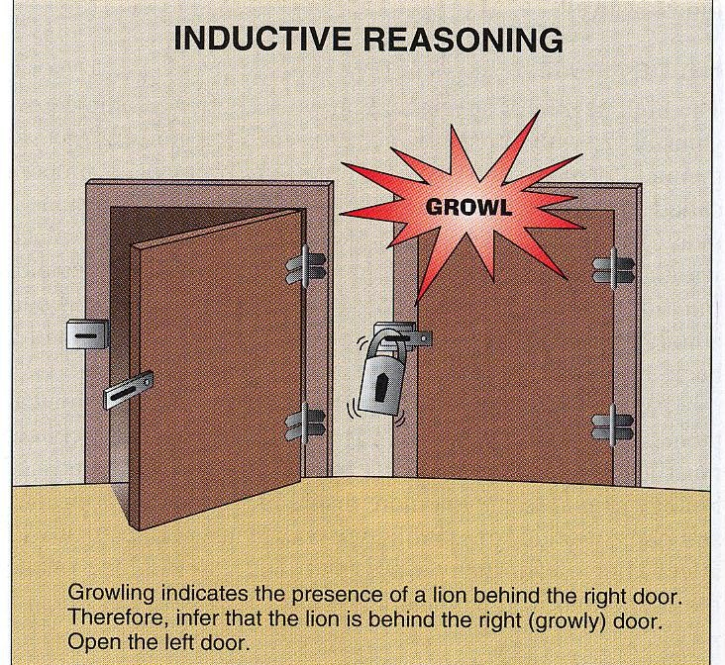

Slide 51
Do the following enterprises use inductive, abductive or
deductive reasoning more?
Scientific Inquiry
Mathematics

Slide 52
Type | Role in Science
Inductive | Scientists observe repeated phenomena and derive general theories. Example: "Every time this chemical reacts with oxygen, it gives off heat. Therefore, combustion is exothermic."
Abductive | Used to generate hypotheses or explanations for observed data. "The plant is wilted — maybe it lacks water."
Deductive | Used later to test theories through prediction. "If our theory is correct, then X should happen under condition Y."
Scientific reasoning moves between all three, but starts inductively, hypothesizes abductively, and tests deductively.

Slide 53
Type | Role in Math
Deductive | Central to mathematics. Proofs begin with axioms and definitions and deduce truths. Example: "Given that all even numbers are divisible by 2, and 8 is even → 8 is divisible by 2."
Inductive | Occasionally used in pattern recognition, especially in exploratory or applied math (e.g., finding sequences), but the conclusions are not accepted as true until proven deductively.
Abductive | Rare, but can appear when forming conjectures. Example: "This pattern appears true in multiple cases — perhaps it's universally true?"
Enterprise | Dominant Reasoning Type(s)
Scientific Inquiry | Inductive + Abductive (for discovery), then Deductive (for testing)
Mathematics | Deductive (for proof), with occasional Inductive (for intuition/patterns)

Slide 54
Mathematics
Science
deductive reasoning
inductive reasoning
abductive reasoning
Science and mathematics are fundamentally different. Science is grounded in empirical observation

Slide 55
Inductive reasoning-More examples
If the sky is getting very dark and cloudy, it is probably going to rain.
If I don’t eat something, I will get hungry.
If I turn on the light switch, the light will come on.

Slide 56
If I turn on the light switch, the light will come on.
Step | Type of Reasoning | Role
Observing the pattern | Inductive | “The light always comes on when I flip the switch.”
Forming the hypothesis | Abductive | “Maybe the switch causes the light to turn on.”
Making the prediction | Deductive | “If I flip it again, it will turn on.”
Hypothesis
Hypotheses are testable predictions
Reasoning types combine: induction, abduction, and deduction
Confirmed?
Supported?
Falsified?
Evidence

Slide 57
Many of us, a lot of the time, will tend to look for evidence that supports our hypothesis (only).
Hypothesis
Confirmed?
Supported?
Falsified?
Evidence

Slide 58
Deductive reasoning
There is a much greater amount of research conducted on deductive reasoning than on inductive reasoning.
This is primarily for reasons of practicality. It takes many trials in order to make a single induction. Also, inductive reasoning is not precise or definite like deductive reasoning is.

Slide 59
Conditional reasoning is reasoning about propositions using the logical relation known as implication.
Formally, it is based on propositional logic
‘if….then’, ‘if…& only if ’ (also not, and, and or are used in propositional logic)

Slide 60
A proposition is a special kind of sentence.It makes an assertion. E.g. The cat ison the mat
A proposition P is assumed to be either True or False
Given several propositions, we may be able to validly infer other propositions.

Slide 61
Modus Ponens
Given these two propositions:
if p then q
P is true
We can validly conclude
q must be true
if p then q
p
if Socrates is a man then he is mortal Socrates is a man
therefore q
therefore, Socrates is mortal

Slide 62
Modus Tollens
Given these two propositions:
if p then q
not q
We can validly conclude
not p
if p then q
not q
if there is fire then there is oxygen there is not oxygen
therefore not p
therefore, there is not fire

Slide 63
Modus Ponens
Modus Tollens
Premise 1: If p then q Premise 2: p Therefore: q
Premise 1: If p then q Premise 2: not q Therefore: not p
Both are valid!
People tend to be better at using MP than MT

Slide 64
Is this valid?
If Susan is angry, then I will be upset I am upset
Therefore, Susan is angry

Slide 65
Fallacy 1: Affirmation of the Consequent
If p then q
q
therefore:p
FALLACY!
*If I do well on the test, I will get drunk at the weekend (Don’t do )
* I got drunk at the weekend
*Therefore: I must have done well on the test (I can’t remember) (Disciplinary Committee )
Note that I may or may not have done well on the test. The argument is flawed. That’s all.

Slide 66
If p then q
Fallacy 2: Denying the Antecedent
FALLACY!
If it rains, the ground will be wet. It is not raining. ❌ Therefore, the ground is not wet.
not p
Therefore not q
If I do well in the test, I will get drunk
I failed the test
Therefore: I will not get drunk

Slide 67
antecedent
consequent
if A then B
Affirming the antecedent (correct): A, therefore B Denying the consequent (correct): not B, therefore not A Affirming the consequent (wrong): B, therefore A Denying the antecedent (wrong): not A, therefore not B
Evenif A and B are both true, the first two ways of reasoning are correct, and the second two are incorrect.

Slide 68
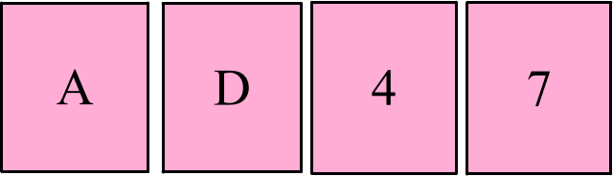
The Wason Selection Task
Assume: Each card has a letter on one side and a number on the other
Rule: If there is a vowel on one side, then there is an odd number on the other.
Q:Which card(s) must you turn over to test the rule?

Slide 69
If V O W E L
then O D D
Affirming the antecedent (correct): A, therefore B
Denying the consequent (correct): not B, therefore not A
Affirming the consequent (wrong): B, thereforeA Denying the antecedent (wrong): not A, therefore not B

Slide 70

D
A
4
7
Selecting the card with the letter A resembles use of the modus ponens argument: we need to check that a vowel always leads to an odd number to verify the rule.

Slide 71

D
A
4
7
The selection of the 4 resembles the use of the modustolens argument: we need to check that not odd rea ly does imply not a vowel to verify the rule.

Slide 72
D
A
4
7
Incorrectly selecting the 7 resembles the affirmation of the consequent falacy.
If p then q q
therefore: p

Slide 73
D
A
4
7
Incorrectly selecting D is…..
…. Denial of the antecedent.
W hy? W hy is this a fallacy?

Slide 74
Syllogistic reasoning
A syllogism is a piece of deductive reasoning that consists of a major premise, a minor premise and a conclusion. Syllogisms have the following general from:
Major premise: Minor premise: Conclusion:
Example:
All/Some/No M are [not] P. All/Some/No S are [not] M. Therefore, All/Some/No S are [not] P.
All Frenchmen are cheese-eaters
All cheese-eaters are surrender-monkeys Therefore, all Frenchmen are surrender-monkeys
The above syllogism is logically valid (even if the conclusion is untrue). The truth of a conclusion depends both on the validity of the argument and the truth of the premises.

Slide 75
There are 512 ways of combining the All, Some, No and Not quantifiers, producing 512 possible syllogisms. Most of these do not produce logical arguments.
As we saw for conditional reasoning, people often make errors when
making judgments about arguments involving syllogistic reasoning.
For example, consider:
All French-men are cheese-eaters Some cheese-eaters are farmers
Therefore, some Frenchmen are farmers
The conclusion does not follow logically from the premises. However, people often judge the argument to be a valid one. (Johnson-Laird, 1990)
Such findings can be explained by belief biases – people make judgements based on prior beliefs and knowledge rather than on the rules of logic

